Slide 1
Amazon Sales For 2019
By Suhail Sharafuddin

Slide 2
Context
Many companies are using predictive analytics to figure out future sales
Using Amazon sales, see if I can predict future sales

Slide 3
The Problem Statement
Becoming more important to be able to predict future sales
Quantifies growth, propels growth, and aids in target attainment
Using Amazon’s sales data, create models that will predict sales

Slide 4
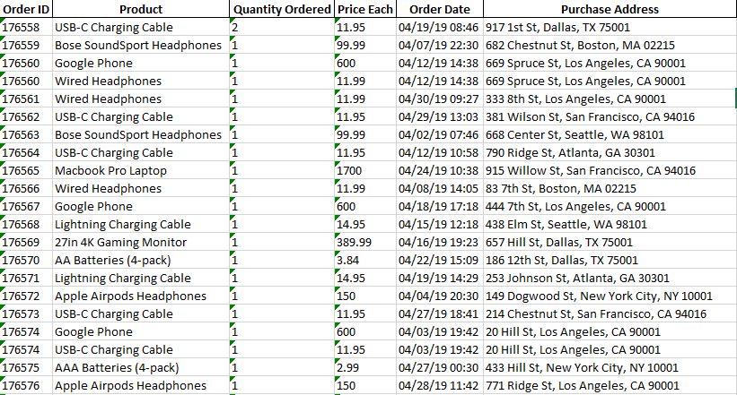
Data
186,306 rows(orders) of data
12 files for 12 months of 2019

Slide 5
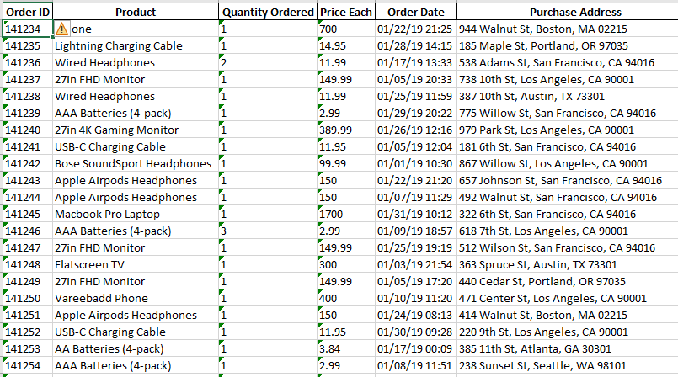
Data Wrangling
Concatenate 12 files
Put in order by Order ID
Dropped all NAN rows

Slide 6
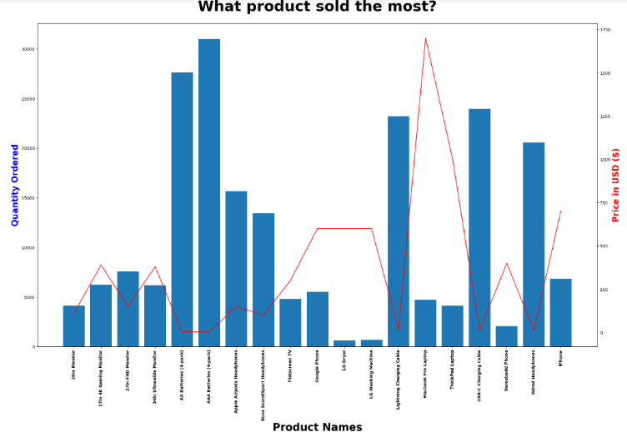
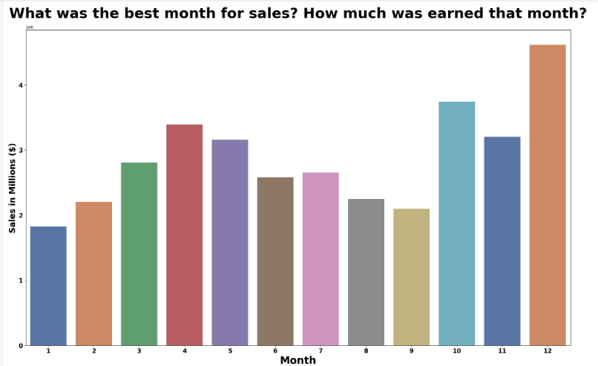
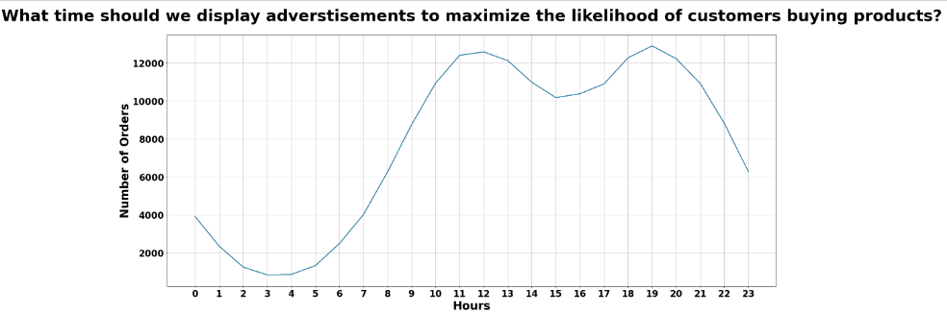
Exploratory Data Analysis

Slide 7
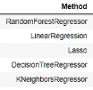
Model Selection
Methods With Highest Accuracy Ranked
Models Chosen:
Linear Regression
Random Forest Regressor

Slide 8
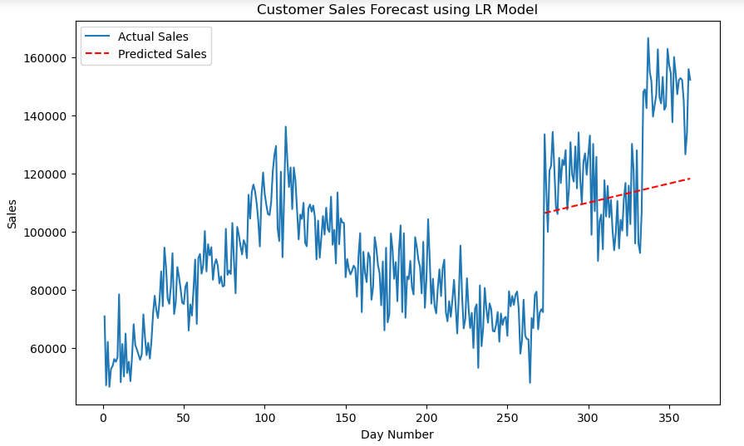

Linear Regression

Slide 9
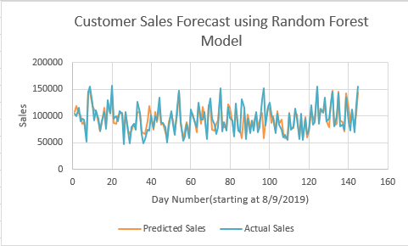

Random Forest Regressor

Slide 10
Takeaways
Linear Regression did not give legitimate R² score
Random Forest was much better model
Lack of data was biggest hindrance
Redundancy in parameters

Slide 11
Future Research
Use 3-5 years of data for more trends
Same analysis with more specific stores’ sales data

Slide 12
Questions?

